Slide 1

L earn
E asy
R ead
E asy

Slide 2





Who We Are ?
Elif
SOLMAZ
Kenan ÖZÜTEMİZ
Büşra KARAUSTA
Dr. Instructor
Gül TOKDEMİR
OTSIMO
Developer & Game Designer
Developer & Graphic Designer
Developer & Software Architecture
ADVISOR
ADVISOR COMPANY

Slide 3
OTSIMO
Otsimo is a company that develops mobile games to help educate children with autism. Their story has been going on for a long time. The games they developed have not only reached thousands of children and their families, but also help schools.

Slide 4

AUTISM
Autism Spectrum Disorder (ASD) is a pervasive developmental disorder which affects individuals with varying degrees of impairment.
The education of autistic children is not limited to school or individual therapies and is a twenty-four-hour process that must be continued in all aspects of life.

Slide 5
What is LERE ?

Slide 6
Our game is an educational game for children that help the education of children in need of special attention.
It is a mobile game series consisting of small play pieces developed for the education of children with autism.
This educational game mobile app allow children to learn while having fun.
Parental Control of the application allow the parent to actively monitor the child's development.

Slide 7
What Were
The Problems ?

Slide 8
Problems and Needs
Special Attention
Focusing Problem
They need extra attention compared to other children.
They have difficulty focusing for a long time.
Special Education
Learning Difficulty
They also need education outside the school.
For different reasons, learning speeds are slower than other children.

Slide 9
Solutions For These Problems

Slide 10

Solutions
Parent Control
Focusing and Motivation
Control mode for checking the development of the child and the necessary education.
Games and trainings for multiple emotion organs.
Educational Game Series
Learning Difficulty
An environment in which they can continue basic education outside the school will be provided.
To strengthen the reinforcement by repeating the trainings at regular intervals.

Slide 11
What We Used
To Solve ?

Slide 12

Alphabet Games
Alphabet Education & Test
Colors Games
Color Education & Tests
Number Games
Number Education
& Test
2
1
3
Parent Control

Slide 13
LERE’s
UI DESIGN

Slide 14
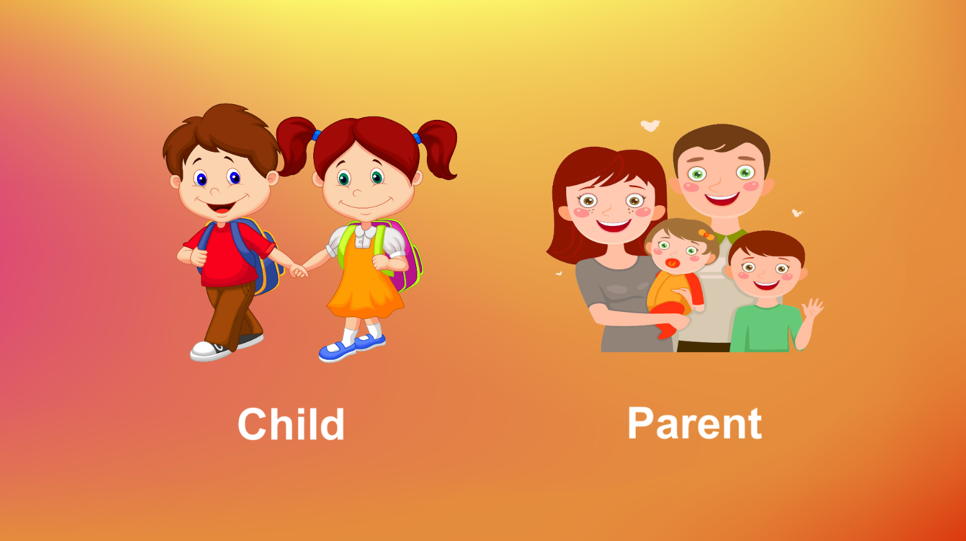
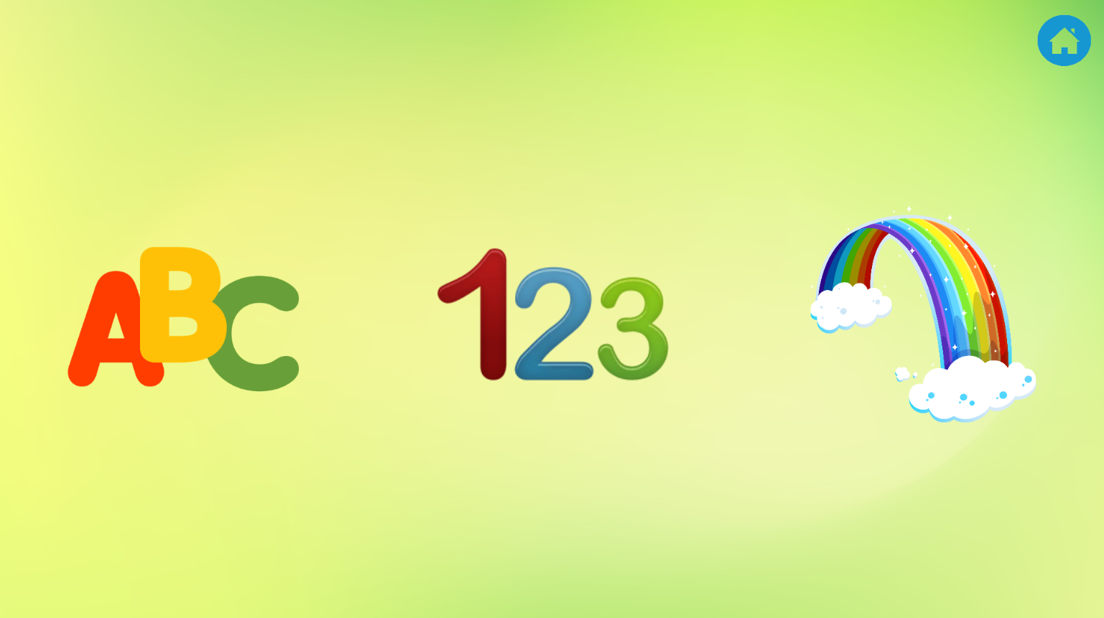

Child/Parent Selection Parts
Training
Catogories Parts

Slide 15


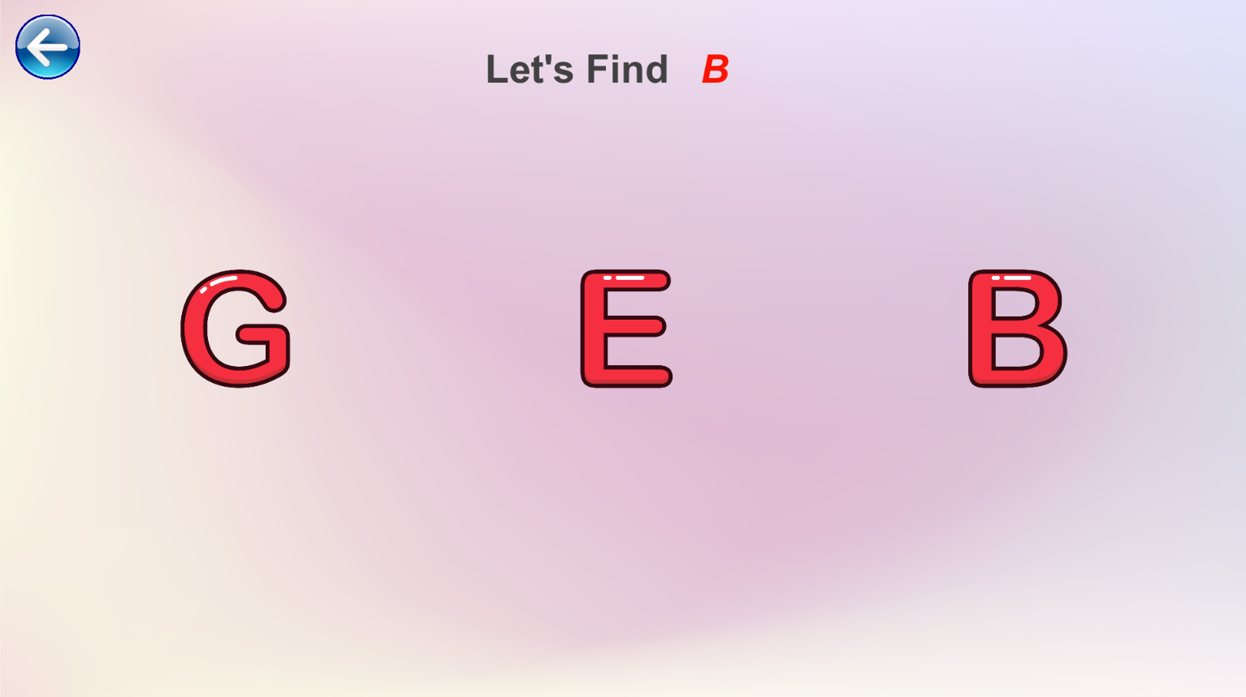
Alphabet Parts

Slide 16

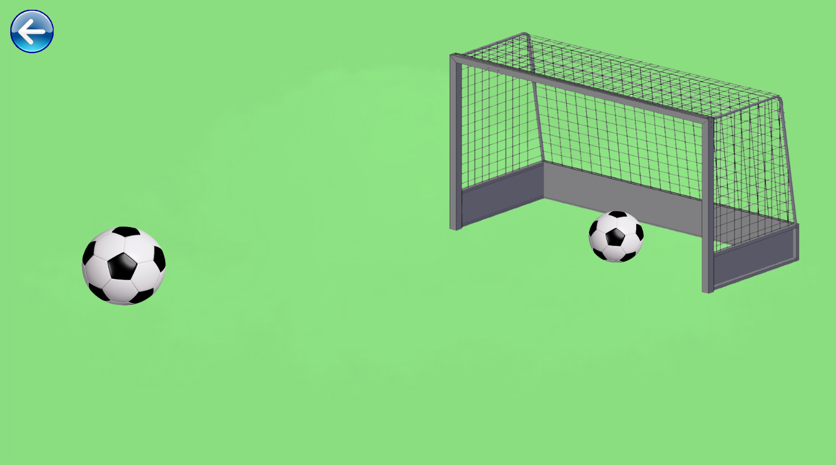
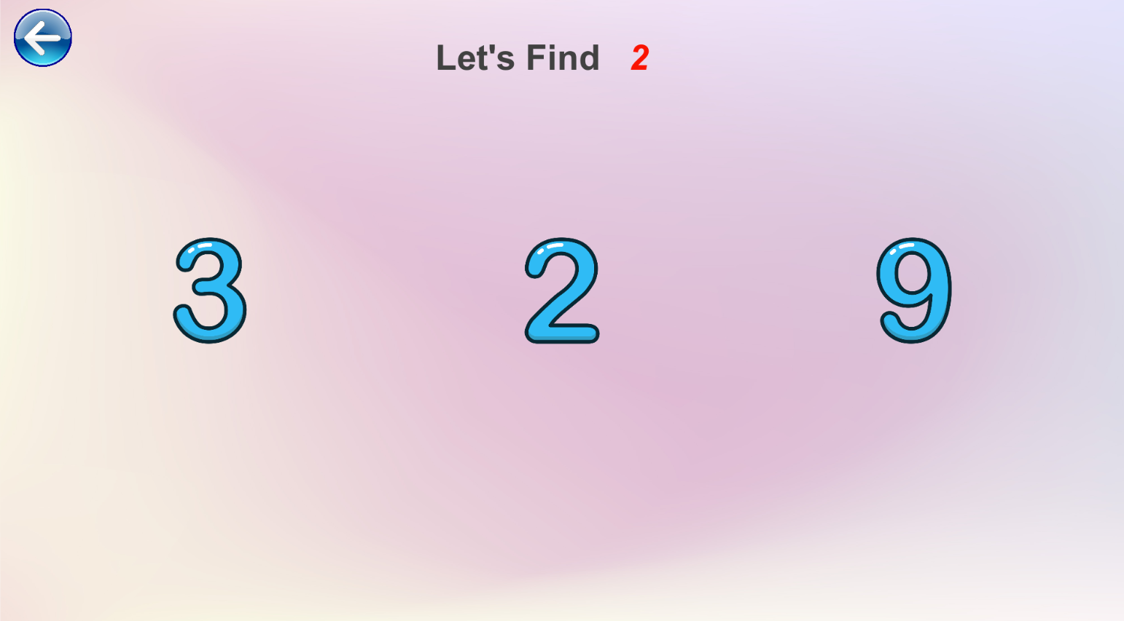
Number Parts

Slide 17

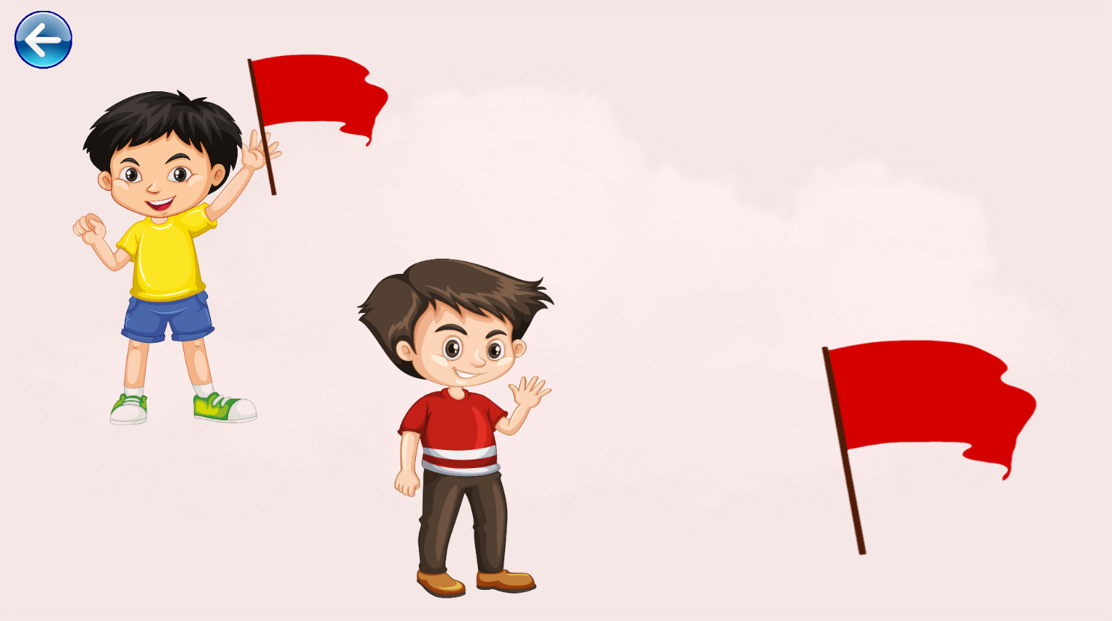
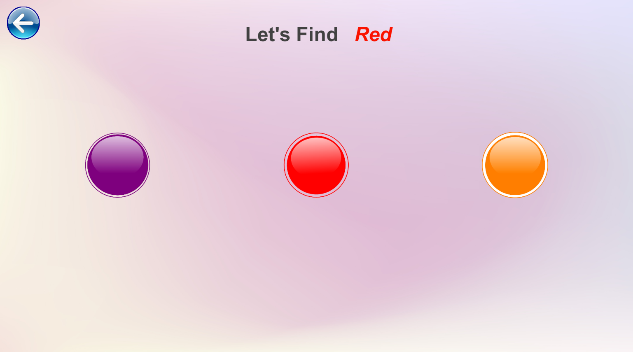
Color Parts

Slide 18
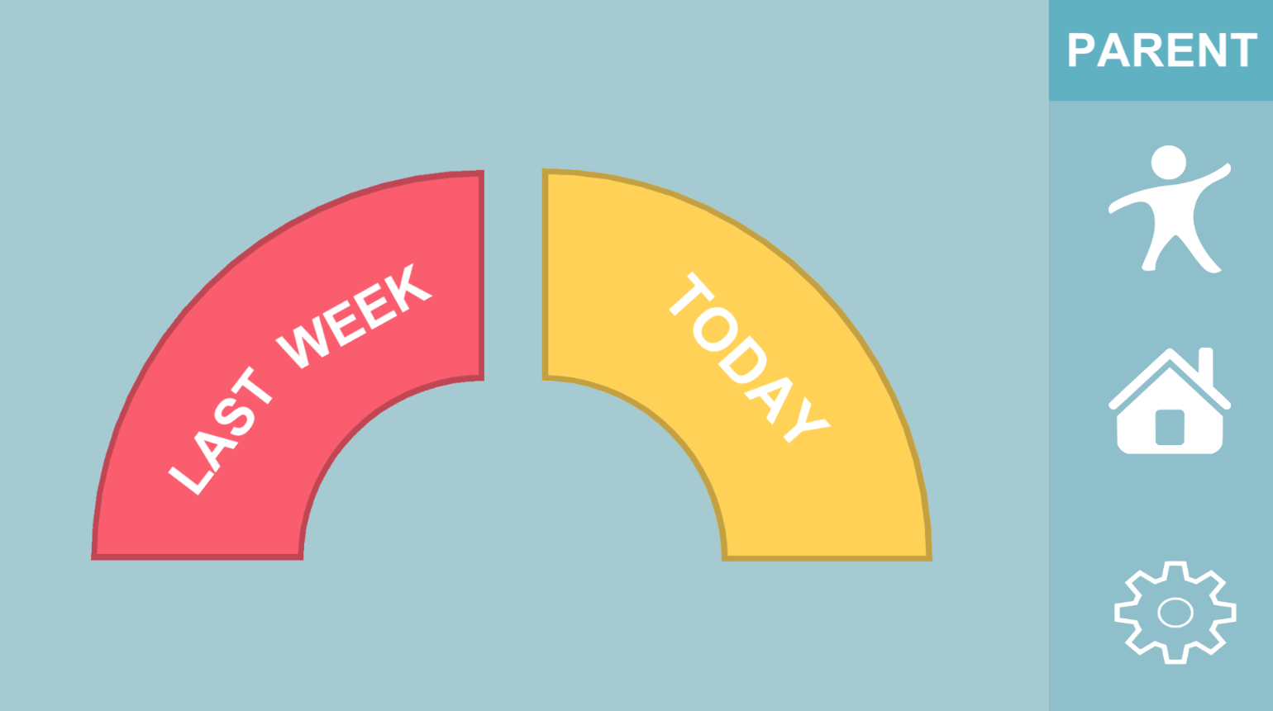
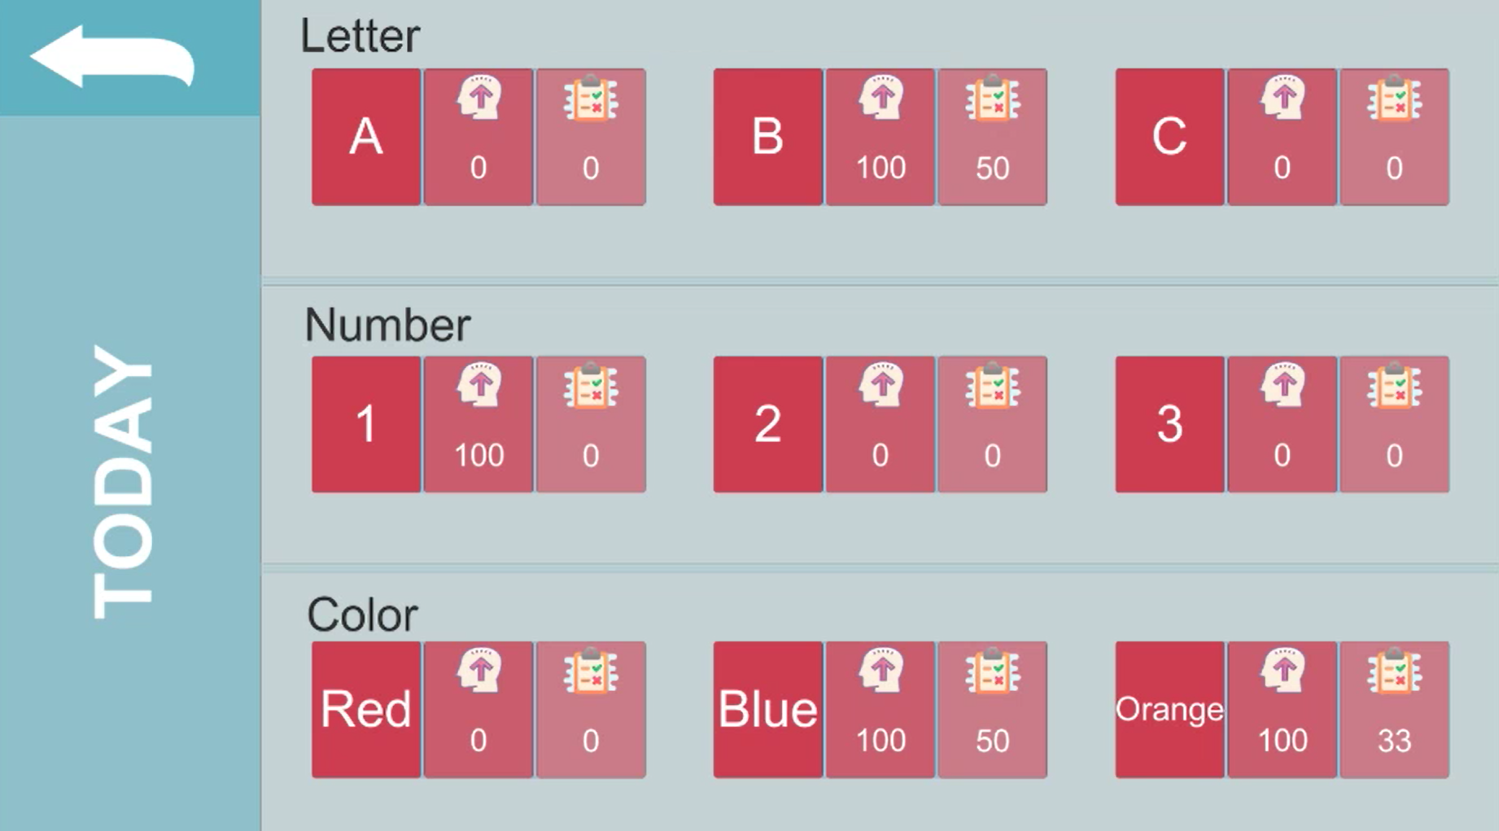
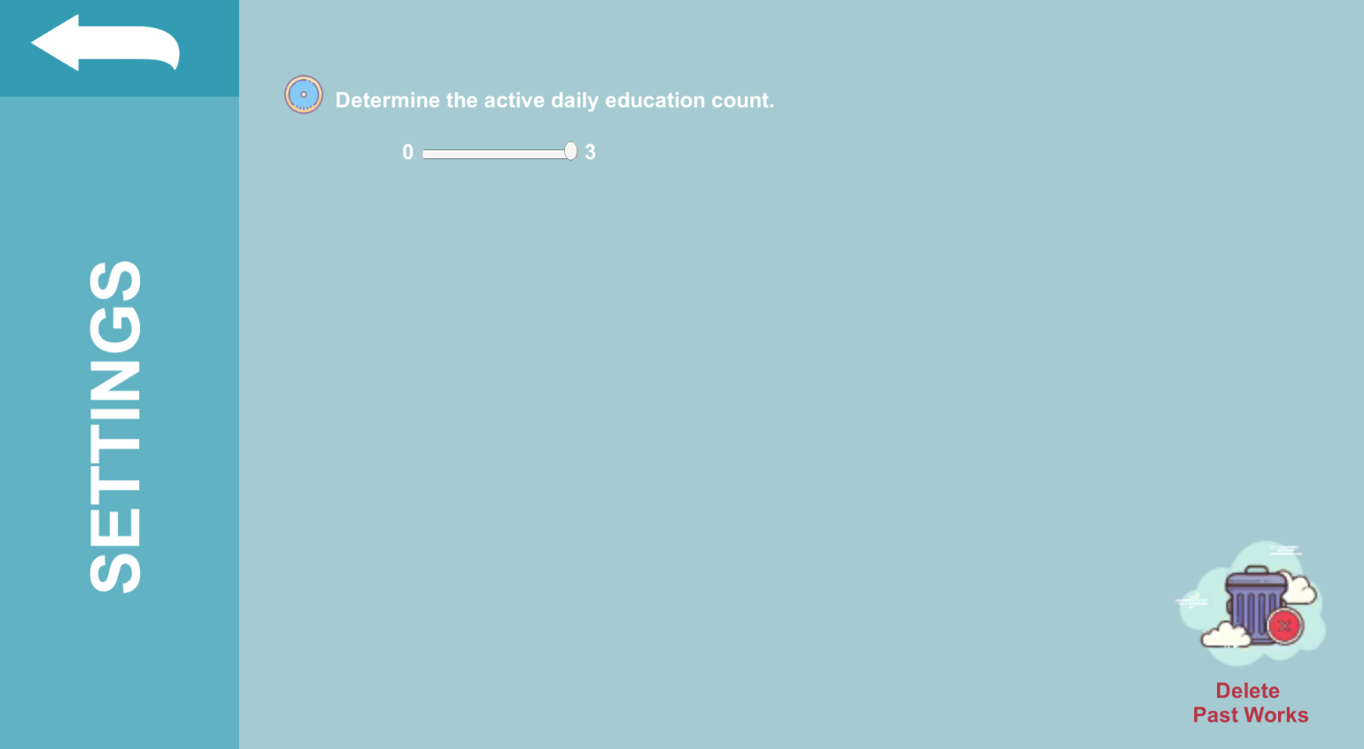
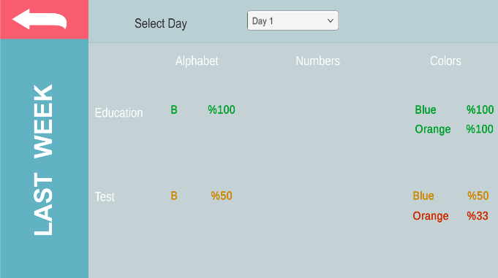
Parent Parts

Slide 19
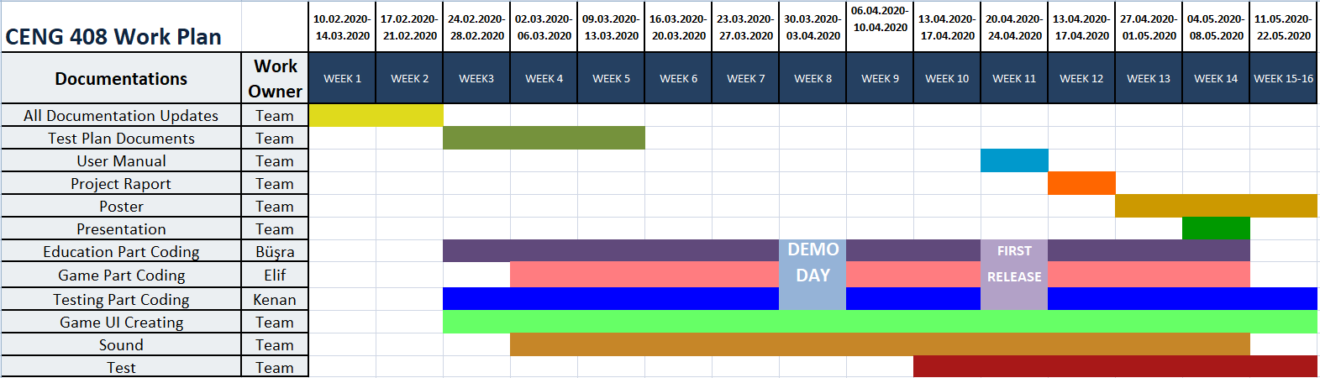
WORK PLAN

Slide 20

Thanks
For Listening

